Slide 1
Multiplication Grid HAcks
Mrs Parlevliet

Slide 2
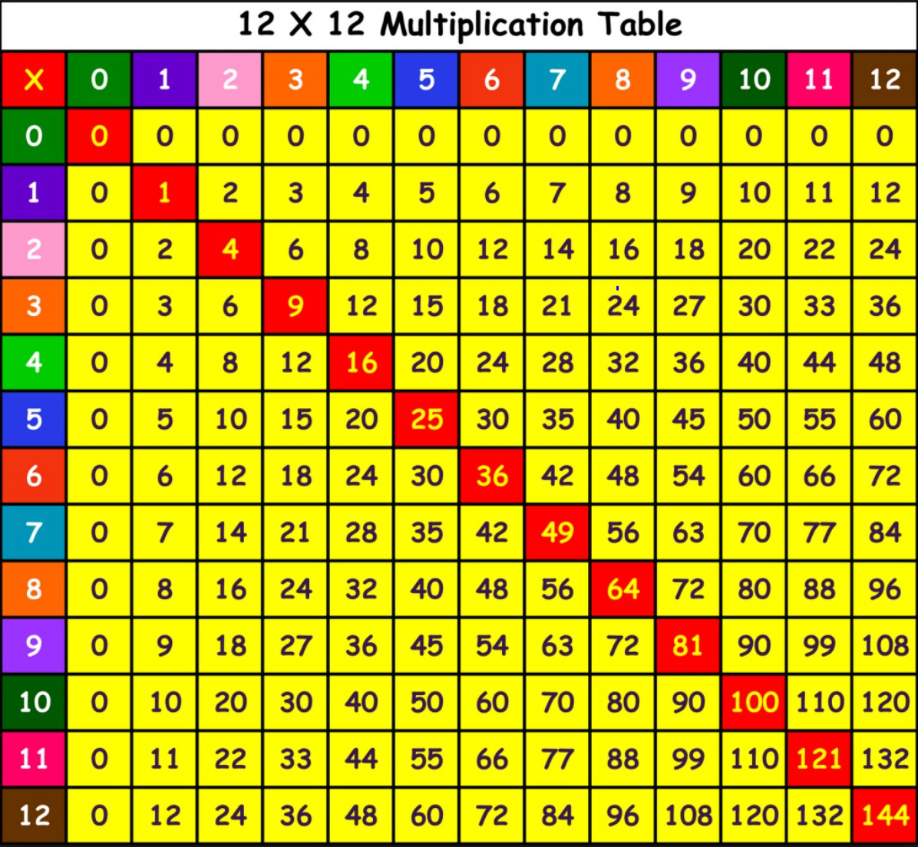
Fill in the 1’s Column First
You’ve already got the answers.
Anything multiplied by 1 is itself.

Slide 3
The 2’s Column
Double the value.

Slide 4
The 10’s Column
Add a zero.

Slide 5
The 5’s Column
Halve the values in the 10 column.

Slide 6
The 4’s Column
Double the values in the 2 column.

Slide 7
The 8’s Column
Double the value in the 4’s column.
If you double something three times it is the same as multiplying by 8

Slide 8
The 3 Column
Count up in 3’s

Slide 9
The 6 Column
Double the values in the 3 column

Slide 10
The 9 Column
https://www.youtube.com/watch?v=sZHjuf75u20
OR
https://www.youtube.com/watch?v=CVbcra3rCqc

Slide 11

The 7 Column
You’ve got the answers to a lot of them in other columns.
Remember,
$4×7=28$ and $7×4=28$
It’s only
$7×7=49$ and $12×7=84$ that are new ones to fill in.

Slide 12


Line of Symmetry
The values on either side of the red squares are the same.
You only really need to remember half of your times tables.
Remember,
$2×8=16$ and $8×2=16$

